Slide 1

Best location for a company building installation

Slide 2
Background
A new multinational company working in the domain of telecommunication want to install its offices in Toronto city. But, it hasn't any idea where in Toronto should be localized. Thus, it provides her plan and what should be present in the area of the company buildings to help selecting the best location for it. The company will open more than 10 000 positions with different skills and accessible also for non-Canadian people. It will not integrate restaurants in the buildings. Thus, the presence of restaurants near the company is something critical. As it will be open for many origins, many culinary specialties are recommended. The company will receive many customers from all over the world. The presence of an airport not far from the company will be a good criterion for location selection. The company wants also that employees could take advantage of the means of leisure (e.g. gym, coffee, spa, yoga studio, Park, etc.) close to the company during the break time or after the end of work. Thus, the presence of these means will be a good criterion of selection.

Slide 3
Objective
Classification of different neighbourhoods in Toronto city based on company requirements
The neighbourhood with the higher score will be the best location to install its buildings.

Slide 4
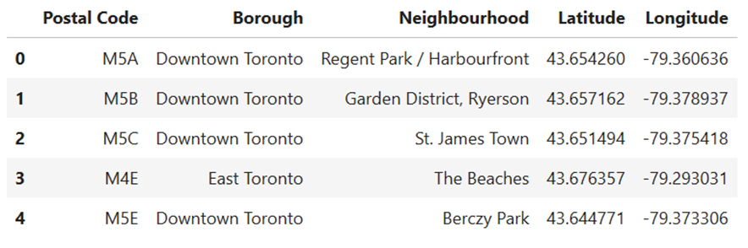
Input Data

Slide 5
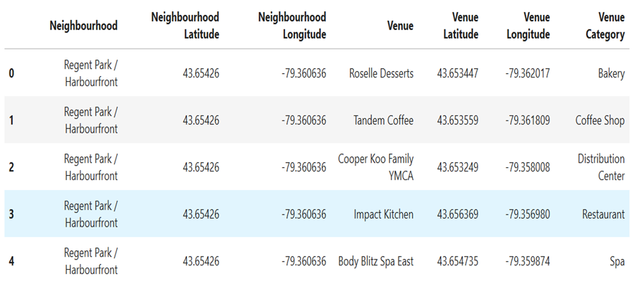
Getting list of venues using Foursquare API

Slide 6
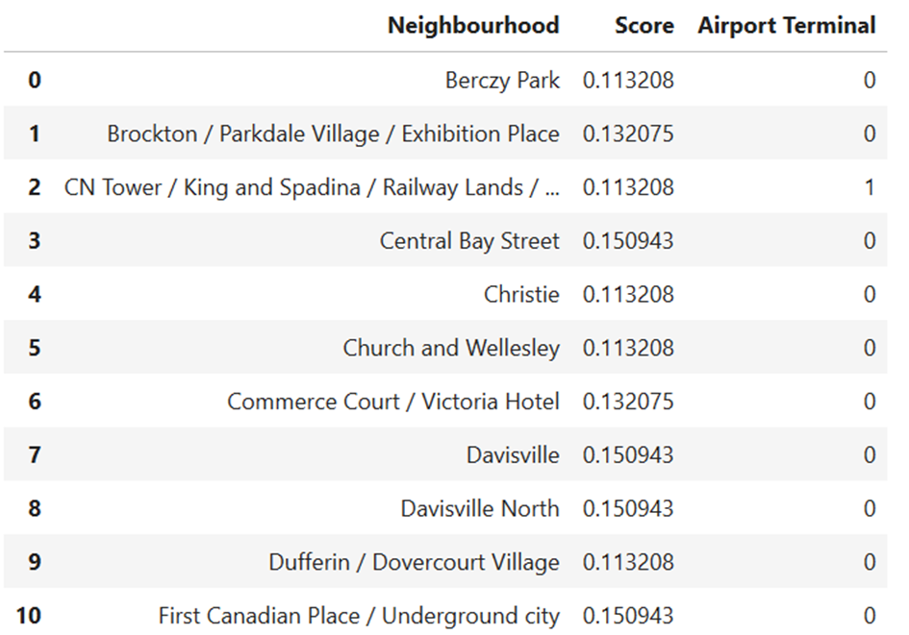
Result: scores per neighbourhood

Slide 7
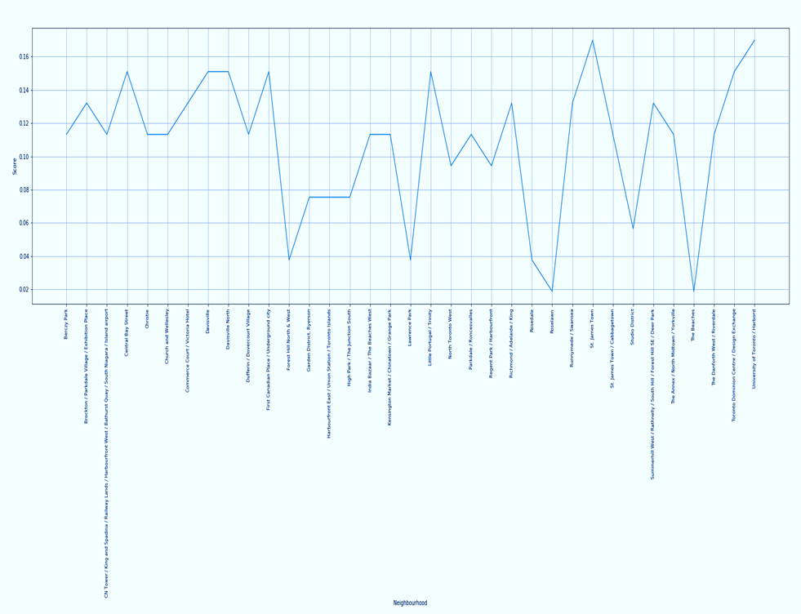
Scores repartition per neighbourhood

Slide 8
Conclusion
The neighbourhood with the highest score while an airport terminal is present is selected for the company building.
The best neighbourhood for the company building is : 'CN Tower / King and Spadina / Railway Lands / Harbourfront West / Bathurst Quay / South Niagara / Island airport'

